Slide 1
Household Energy Usage
By
Akshay Chellappa
Jordan Eshet
Nicole Phelan

Slide 2
Agenda
Background of Data
Data Consolidation, Conversion, and Sorting
Underlying Question
Analysis of Data and Results
Conclusion

Slide 3

Background of The data
Data generated from a 2009 Survey by the U.S. Energy Information Administration (www.eia.gov)
Data consists of information regarding household energy usage, annual income, geographic location, area of household, and other demographic and household related information
Over 30 MB of data consisting of 12k rows x 900 columns
Data collection procedure – random sampling
SURVEY
http://www.eia.gov/survey/form/eia_457/form.pdf

Slide 4
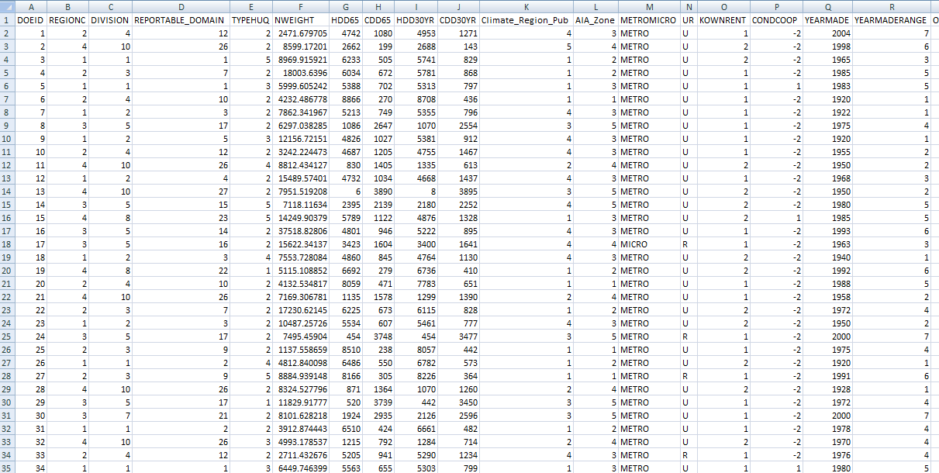
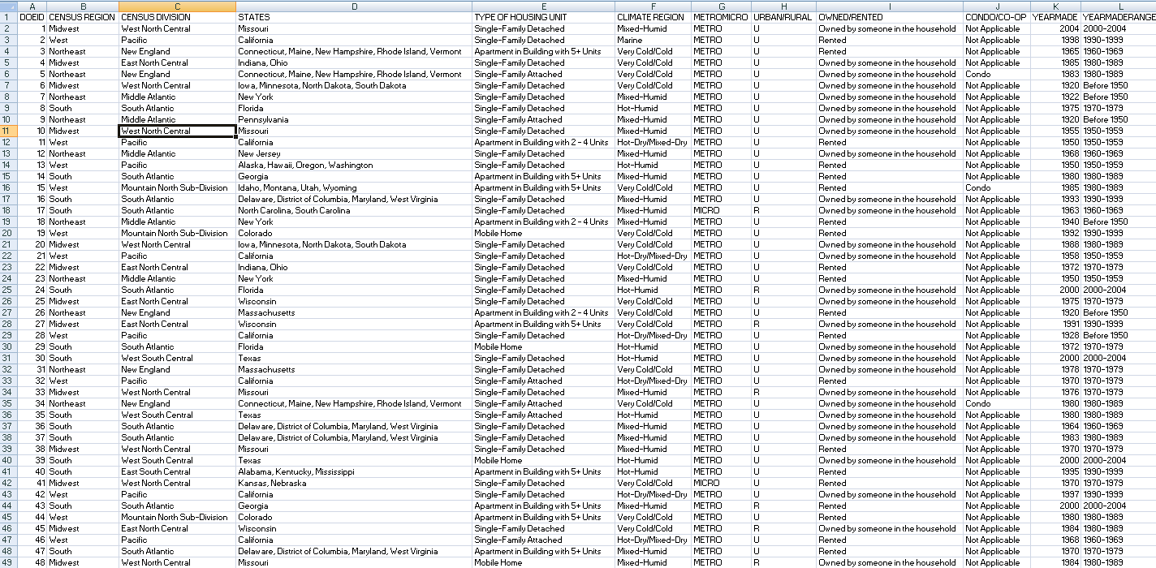
Data consolidation and Sorting
Trimmed dataset to under 20 MB of useable and useful data for analysis
Focused on data specific to household electricity usage, annual income, geographic location, area of household, and appliances within the household
Reduced data from 900 columns to 300 useable columns

Slide 5
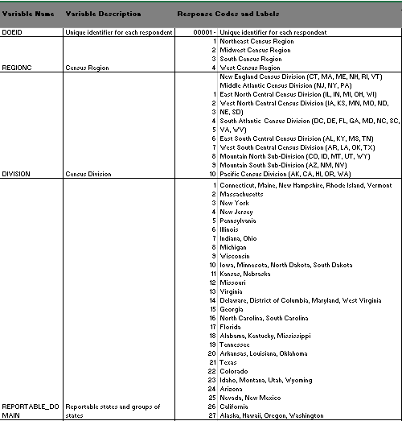
Process of Data CONVERSION
Code book had information on what each column represented
Integrated codes into master Excel sheet by using the following functions
Filtering
Find and replace
Vlookup function

Slide 6
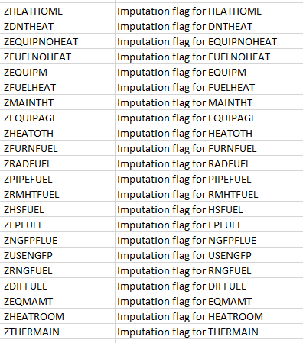
Process of Data Sifting
Omitted columns identifying if a data column was flagged for imputation (substituting missing data)
Omitted columns that were redundant and didn’t add additional value to our focus i.e. second used TV
Using the filter function, each column was given a filter and the ranges were added if necessary

Slide 7


How data was analyzed
Created a master Excel file with all data
Two prong approach – Stat tools and Tableau
Used Stat Tools to get information on summary statistics
Uploaded data into Tableau – software for data analytics for better visualization and business intelligence
Using Tableau, attempted to visualize different combinations of discrete and continuous data, comparing different fields and measures to identify trends and correlations or lack thereof

Slide 8
Underlying question
What factors affect energy usage and consumption?
Income
Type of appliance
Household area
Geographic region

Slide 9
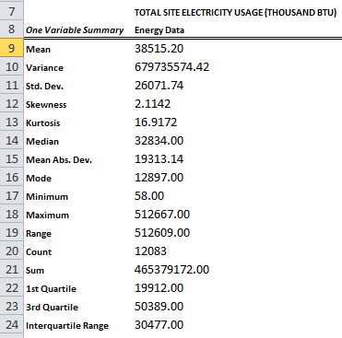
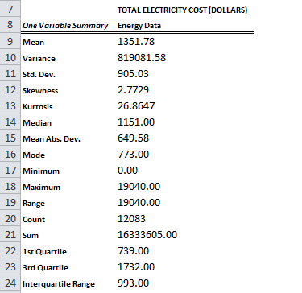
STATISTICAL Summary
Energy Usage
Annual Energy Cost
Mean – 38515 btu
Standard Deviation - 26071
IQR – 30477
Mean - $1351
Standard Deviation - 905
IQR - 993

Slide 10
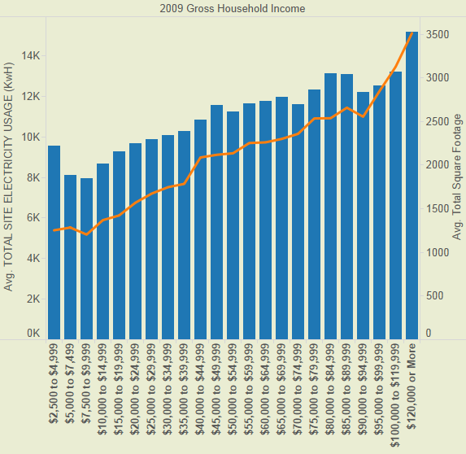

Income and energy usage
The larger the house, the greater the amount of electricity used
The greater your household income is, the less percent of your income is spent on energy
Notes:
As Income increases, a small percentage of gross income is spent on energy. This seems to level off above 40,000.

Slide 11
Refrigerator
Refrigerators are most efficient if under 10 years old and Energy Star
Freezer above refrigerator is the most energy efficient layout of door arrangements on refrigerators
Notes:
Maybe the size of the refrigerators got bigger from 20years to 10 years

Slide 12
Air Conditioning
Programmable Central AC can be more expensive than non-programmable
The more panes of glass, the cheaper the electricity for AC
Notes:
Programmable AC may cost more and may be in bigger homes

Slide 13
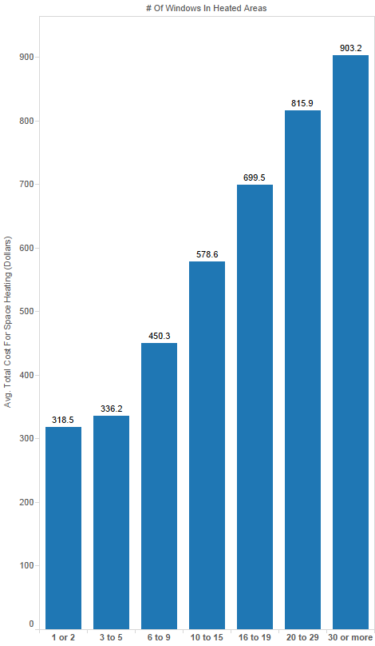
space heating
More money is spent on heating in the Northeast than other regions
The more windows there are the more money is spent on heating

Slide 14
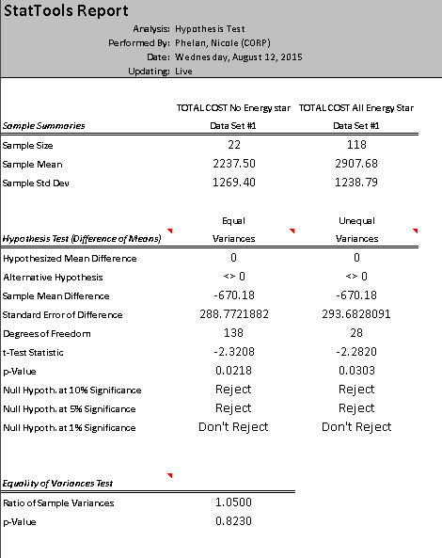
DOES Energy Star Make a difference?
ENERGY START MOST USED REFRIGERATOR | Yes |  | ENERGY START MOST USED REFRIGERATOR | No
ENERGY STAR DISHWASHER | Yes |  | ENERGY STAR DISHWASHER | No
ENERGY STAR CLOTHES WASHER | Yes |  | ENERGY STAR CLOTHES WASHER | No
ENERGY STAR MOST USED WINDOW/WALL AC UNIT | Yes |  | ENERGY STAR MOST USED WINDOW/WALL AC UNIT | No
Average of TOTAL COST (DOLLARS - EXCLUDES WOOD) | Total |  | Average of TOTAL COST (DOLLARS - EXCLUDES WOOD) | Total
Total Energy Star | 2,907.68 |  | Total Not Energy Star | 2,237.50
Count of TOTAL COST (DOLLARS - EXCLUDES WOOD)
ENERGY STAR MOST USED WINDOW/WALL AC UNIT | ENERGY STAR CLOTHES WASHER | ENERGY STAR DISHWASHER | ENERGY START MOST USED REFRIGERATOR | Total
No | No | No | No | 22.00
 |  |  | Yes | 7.00
 |  | Yes | No | 5.00
 |  |  | Yes | 4.00
 | Yes | No | No | 4.00
 |  |  | Yes | 4.00
 |  | Yes | No | 2.00
 |  |  | Yes | 28.00
Yes | No | No | No | 16.00
 |  |  | Yes | 4.00
 |  | Yes | No | 4.00
 |  |  | Yes | 15.00
 | Yes | No | No | 11.00
 |  |  | Yes | 12.00
 |  | Yes | No | 12.00
 |  |  | Yes | 118.00
Grand Total |  |  |  | 268.00

Slide 15
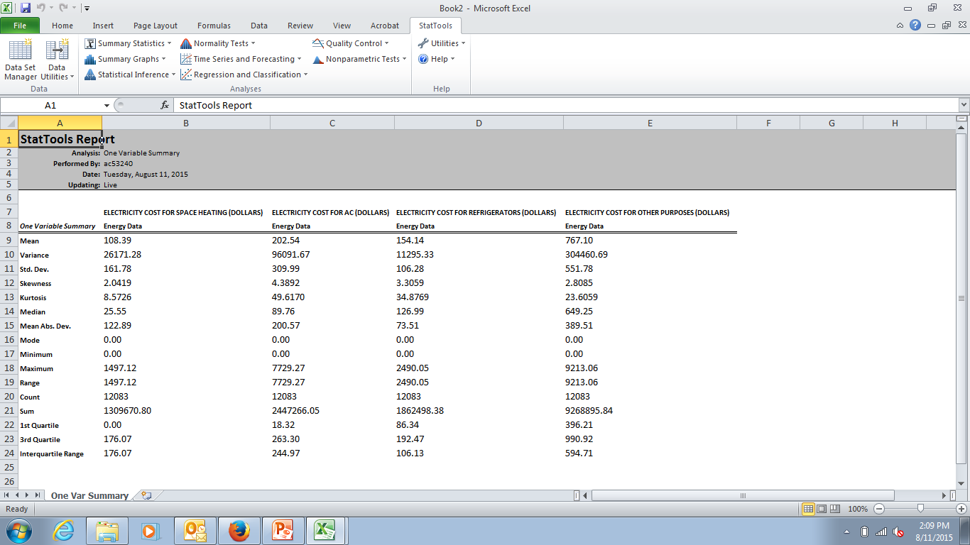
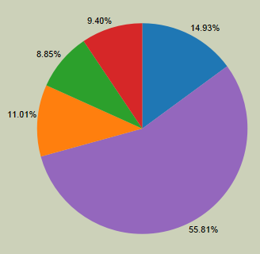
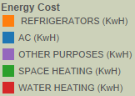
Appliances Summary

Slide 16
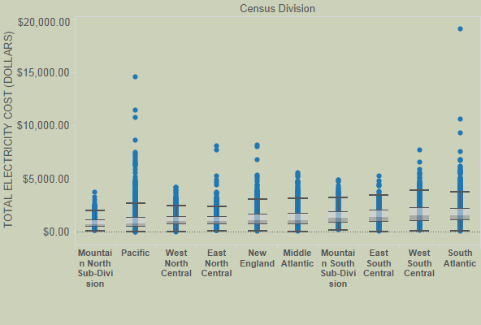
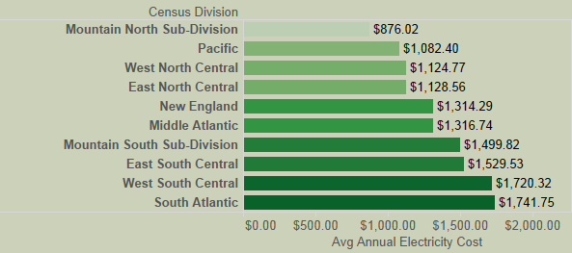
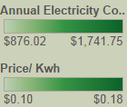
Annual cost of electricity by division
On Average the West South Central and South Atlantic Regions Spend the most in annual energy costs

Slide 17
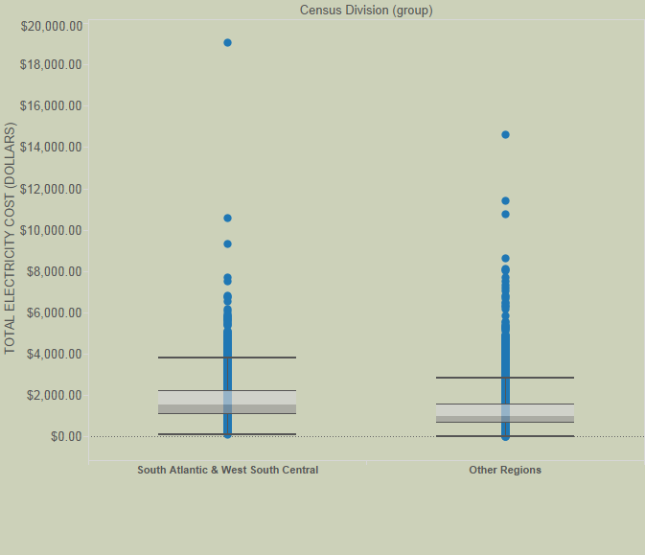
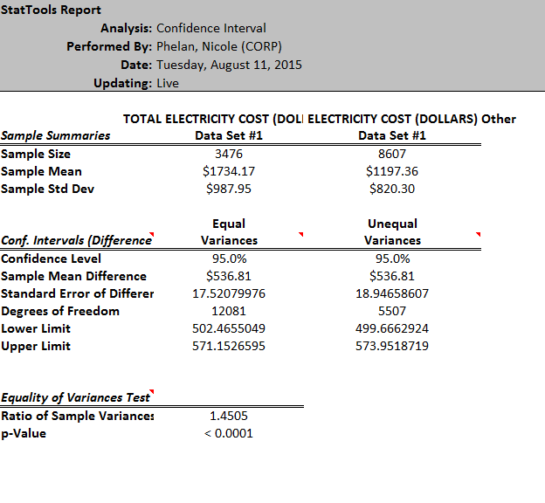
Difference in regional cost
Difference of the mean is between $499.67 and $573.95 with a 95% confidence interval and 5507 degrees of freedom
Notes:
If we were to propose the Null hypothesis that the difference between the mean annual electricity spend of the South Atlantic and West south central was zero (no difference) and the alternative hypothesis that there was a difference, we could reject the null hypothesis and accept the alterative with 5% significance

Slide 18
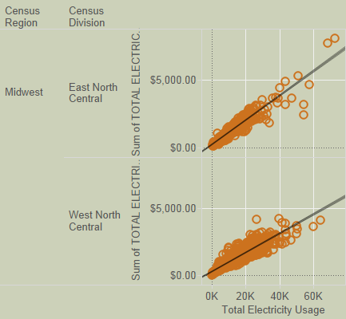
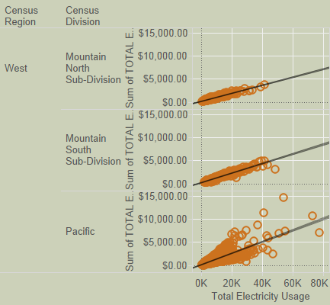
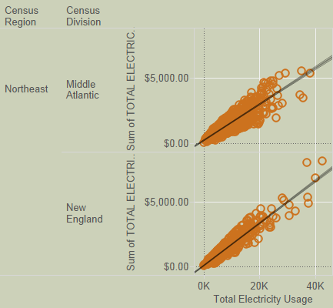
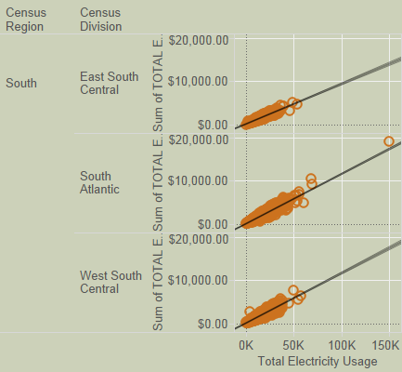
energy cost and electricity usage
High correlation between annual energy cost and total electricity usage R Squared =.835

Slide 19
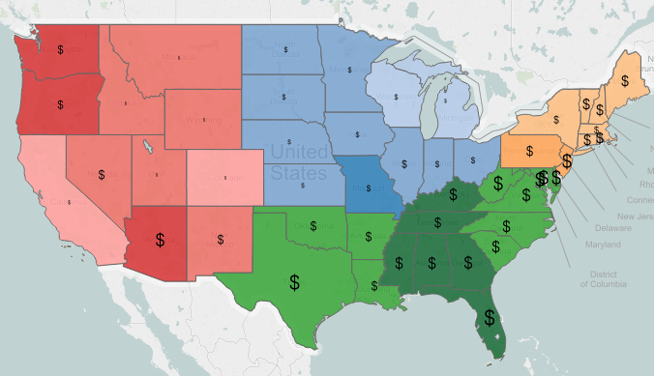
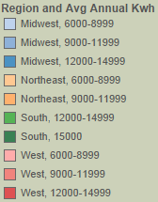
Electricity usage and cost by region

Slide 20
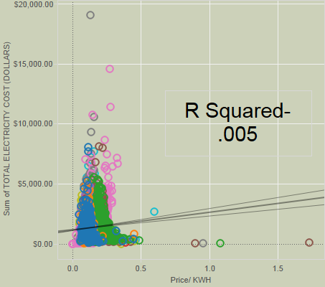
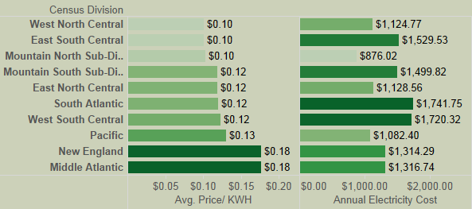
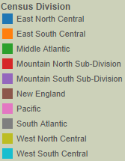
Price Per KWh and total cost
No correlation between price per Kwh and annual electricity usage

Slide 21
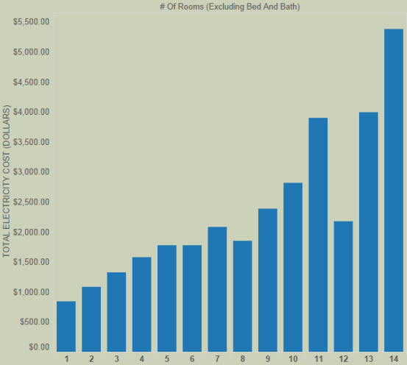
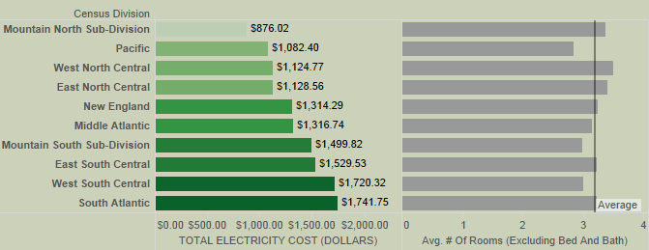
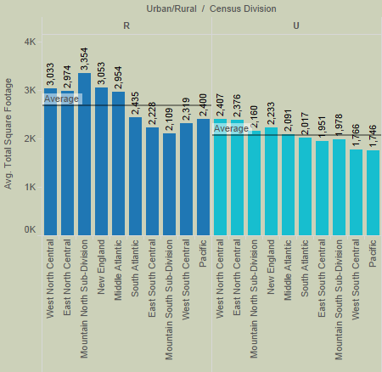
House size and Annual Cost
It does not appear that the South Atlantic or West South Central Regions have larger homes than other regions

Slide 22
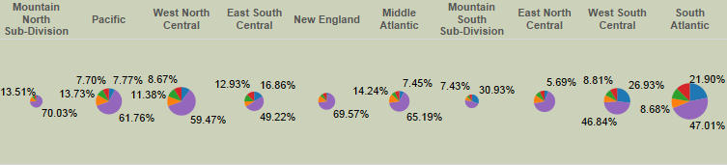
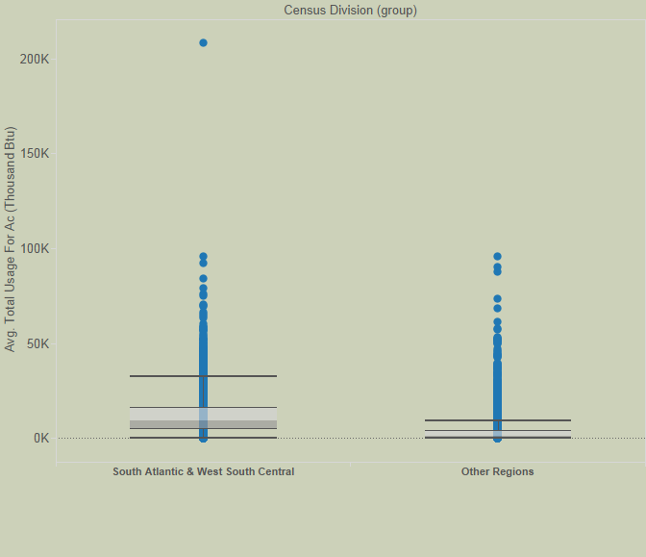
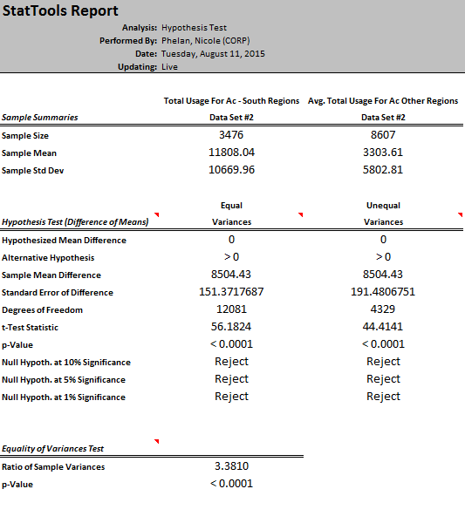
AC Usage and Total Electricity cost
Notes:
Null hypothesis mean annual kwh usage is equal between south Atlantic and west south central regions and the other regions. Alternative hypothesis the difference between south Atlantic and west south central and the other regions is greater than 0. Will reject the null and accept the alt hypothesis with greater than 1% significance. In the F test we see the variance between these groups are not equal but it doesn’t effect our conclusion

Slide 23
Conclusion
The west regions have the highest annual energy costs
The most expensive regions have higher AC usage on average
Price per Kwh does not largely impact annual energy costs
Larger homes have higher energy costs each year
Refrigerators with the freezer above the refrigerator is the most cost/electricity-efficient type of refrigerator
Triple-pane windows will keep your electric bill down
Depending on confidence levels, Energy Star appliances may or may not be more efficient than non-Energy Star
Many factors affect energy usage and consumption…

Slide 24
References
http://www.eia.gov/consumption/residential/

Slide 25
THANK YOU

